Slide 1
Unit 7
Searching, sorting and hashing: 8 hours

Slide 2
Syllabus content
Searching: Linear Search, Binary Search and Fibonacci search.
Sorting: Bubble Sort, Selection Sort, Heap Sort, Insertion Sort, Radix Sort, Merge Sort, Quick Sort.
Analysis of Searching and Sorting Techniques.
Hashing: Hash Functions, Overflow handling, Collision & Collision Resolution Techniques, Linear hashing, Hashing with chaining, Separate Chaining, Open Addressing, Rehashing and Extendible hashing.

Slide 3
Linear Search
Unordered List
One occurrence
All occurrences

Slide 4
Algorithm
Linear Search ( Array Arr, Value a )
Step 1: Set i to 0
Step 2: if i > n then go to step 7
Step 3: if Arr[i] = a then go to step 6
Step 4: Set i to i + 1
Step 5: Goto step 2
Step 6: Print element a found at index i and go to step 8
Step 7: Print element not found
Step 8: Exit

Slide 5
Linear Search
Unordered List
One occurrence (with function and without function)
int search(int arr[], int n, int x)
{
int i;
for (i = 0; i < n; i++)
if (arr[i] == x)
return i;
return -1;
}
All occurrences
int search(int arr[], int n, int x)
{
int i, count = 0;
for (i = 0; i < n; i++)
{
if (arr[i] == x)
{
cout <<x<<“ is present at location ”<<i+1<<endl;
count++;
}
}
return count;
}

Slide 6
Binary search
Given an integer X and integers A0 , A1 , …, AN-1, which are presorted, find i such that A_{i} = X, or return i = -1 if X is not in the input.
6

Slide 7
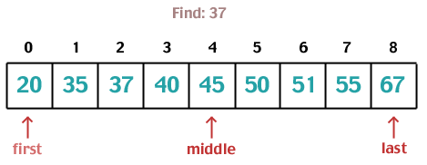

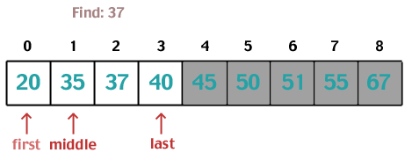
Binary search: Example
7

Slide 8
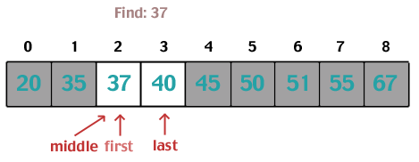
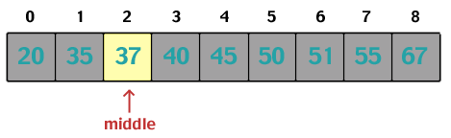
Binary search: Example contd.
8

Slide 9
Algorithm: Iterative
do until the pointers low and high meet each other.
mid = (low + high)/2
if (x = arr[mid])
return mid
else if (x > arr[mid]) // x is on the right side
low = mid + 1
else // x is on the left side
high = mid - 1

Slide 10
Binary search: Iterative
int binarySearch(int []a, int x, int N)
{
int low = 0, high = N-1;
while (low <= high)
{
int mid = (low + high) / 2; // middle subscript
if (a[mid] < x)
low = mid + 1;
else if (x < a[mid])
high = mid – 1;
else
return mid; // found
}
return –1; // not found
}
Homework: Recursive function for binary search
10
Notes:
binarySearch (arr, x, low, high) // recursive
if low > high
return False
else
mid = (low + high) / 2
if x == arr[mid]
return mid
else if x > arr[mid] // x is on the right side
return binarySearch(arr, x, mid + 1, high)
else // x is on the left side
return binarySearch(arr, x, low, mid - 1)

Slide 11
Binary search: recursive
binarySearch (arr, x, low, high)
if low > high
return False
else
mid = (low + high) / 2
if x == arr[mid]
return mid
else if x > arr[mid]
return binarySearch(arr, x, mid + 1, high)
else
return binarySearch(arr, x, low, mid - 1)

Slide 12
Binary search: analysis
The work done inside the while loop clearly takes O (1) time, so the total running time depends on the number of iterations of the while loop.
Each iteration reduces the number of elements remaining to be considered by half, so clearly the number of iterations required is k. Thus T (N ) = O (log N ).

Slide 13
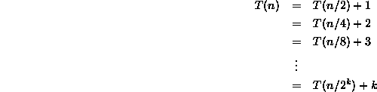
Binary search: analysis Contd

Slide 14
Fibonacci search
Works for sorted arrays
A Divide and Conquer Algorithm
O(log n) time complexity
Divides given array into unequal parts
Binary Search uses a division operator to divide range. Fibonacci Search uses + and -.
Fibonacci Search examines relatively closer elements in subsequent steps. So when the input array is big that cannot fit in CPU cache or even in RAM, Fibonacci Search can be useful.

Slide 15
Fibonacci search process
Find the immediate Fibonacci number that is greater than or equal to the size of the input array. Then, also hold the two preceding numbers of the selected Fibonacci number.
Initialize the offset value as -1
Until Fm2 is greater than 0
Compare the key element with the element at index [min(offset+Fm-2,n-1)]. If a match is found, return the index.
If the key element is lesser value than this element, reduce the range of the input from 0 to the index of this element. The Fibonacci numbers are also updated with Fm = Fm2.
If the key is greater than the element at this index, remove the elements before this element from the search range. The Fibonacci numbers are updated as Fm = Fm1. The offset value is set to the index of this element.
As there are two 1s in the Fibonacci series, there arises a case where two preceding numbers will become 1. So if Fm1 becomes 1, there is only one element left in the array to be searched. Compare the key element with that element and return the 1st index. Otherwise, the algorithm returns an unsuccessful search.
Notes:
https://www.tutorialspoint.com/design_and_analysis_of_algorithms/design_and_analysis_of_algorithms_fibonacci_search.htm

Slide 16
Fibonacci search algorithm
n <- size of the input array
offset = -1
Fm2 = 0
Fm1= 1
Fm = Fm2 + Fm1
while Fm < n do:
Fm2 = Fm1
Fm1 = Fm
Fm = Fm2 + Fm1
done
while fm > 1 do:
i = minimum of (offset + fm2, n – 1)
if (A[i] < x) then:
Fm = Fm1
Fm1 = Fm2
Fm2 = Fm - Fm1
offset = i
end
else if (A[i] > x) then:
Fm = Fm2
Fm1 = Fm1 - Fm2
Fm2 = Fm - Fm1
end
else
return i;
end
done
if (Fm1 and Array[offset + 1] == x) then:
return offset + 1
end
return invalid location;
Notes:
https://www.youtube.com/watch?v=ORjObvjWTAc

Slide 17
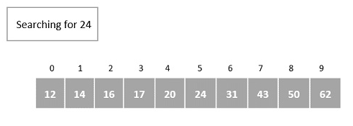
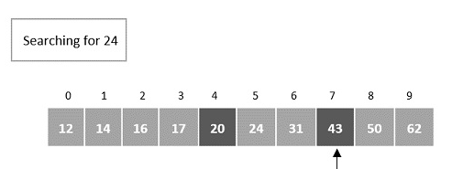
example
Step 3:
update the offset value and the Fibonacci numbers
Offset = 4
Fm = Fm1 = 8; Fm1 = 5; Fm2 = 3
Compare it with the element at index = minimum (offset + Fm2, n – 1) = 7.
Step 1:
n = 10
The smallest Fibonacci number greater than 10 is 13.
Fm = 13, Fm1 = 8, Fm2 = 5
offset = -1
Step 2:
index = minimum (offset + Fm2, n – 1) = minimum (-1 + 5, 9) = 4

Slide 18
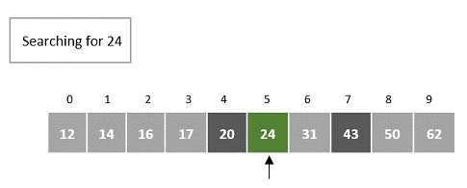
Example contd.
Step 4:
discard the elements after the 7th index, so n = 7
offset value remains 4
Fibonacci numbers are pushed two steps backward, i.e. Fm = Fm2 = 3.
Fm1 = 2, Fm2 = 1
Compare it with the element at index = minimum (offset + Fm-2, n – 1) = 5.

Slide 19
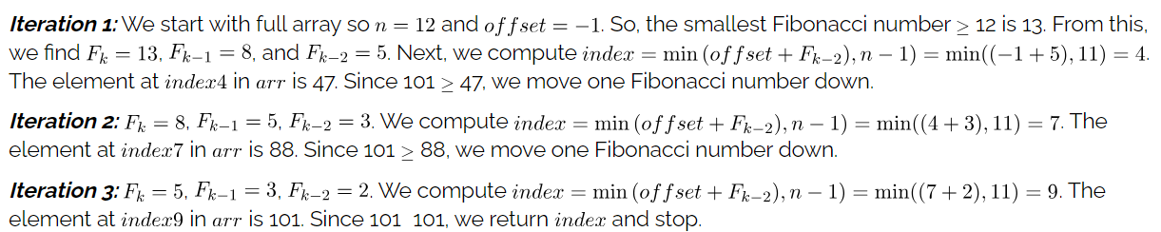
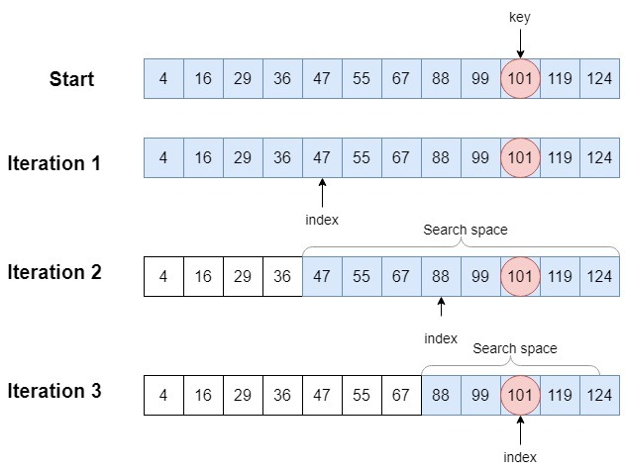
example
Notes:
https://www.baeldung.com/cs/fibonacci-search

Slide 20
What is sorting?
Examples:
Sorting Books in Library
Sorting Individuals by Height (Feet and Inches)
Sorting Movies in Blockbuster (Alphabetical)
Sorting Numbers (Sequential)

Slide 21
Classification
Sorting algorithms are often classified by:
Computational Complexity
Computational Complexity of Swaps
Memory usage
Recursion
Stability

Slide 22
Sorting Algorithms
Bubble Sort
Selection Sort
Insertion Sort
Shell Sort
Merge Sort
Quick Sort
Heap Sort
Bucket Sort
Radix Sort

Slide 23
Bubble Sort
One of the simplest sorting algorithm
Also known as Exchange sort
Notes:
Working:-
* Compares adjacent array elements.
* Exchanges their values if they are out of order.
* Smaller values bubble up to the top of the array.
* Larger values sink to the bottom

Slide 24
Bubble Sort Example
9, 6, 2, 12, 11, 9, 3, 7
6, 9, 2, 12, 11, 9, 3, 7
6, 2, 9, 12, 11, 9, 3, 7
6, 2, 9, 12, 11, 9, 3, 7
6, 2, 9, 11, 12, 9, 3, 7
6, 2, 9, 11, 9, 12, 3, 7
6, 2, 9, 11, 9, 3, 12, 7
6, 2, 9, 11, 9, 3, 7, 12

Slide 25
Bubble Sort Example Contd.
First Pass
6, 2, 9, 11, 9, 3, 7, 12
Second Pass
6, 2, 9, 11, 9, 3, 7, 12
2, 6, 9, 11, 9, 3, 7, 12
2, 6, 9, 9, 11, 3, 7, 12
2, 6, 9, 9, 3, 11, 7, 12
2, 6, 9, 9, 3, 7, 11, 12

Slide 26
Bubble Sort Example Contd.
First Pass
6, 2, 9, 11, 9, 3, 7, 12
Second Pass
2, 6, 9, 9, 3, 7, 11, 12
Third Pass
2, 6, 9, 9, 3, 7, 11, 12
2, 6, 9, 3, 9, 7, 11, 12
2, 6, 9, 3, 7, 9, 11, 12

Slide 27
Bubble Sort Example Contd.
First Pass
6, 2, 9, 11, 9, 3, 7, 12
Second Pass
2, 6, 9, 9, 3, 7, 11, 12
Third Pass
2, 6, 9, 3, 7, 9, 11, 12
Fourth Pass
2, 6, 9, 3, 7, 9, 11, 12
2, 6, 3, 9, 7, 9, 11, 12
2, 6, 3, 7, 9, 9, 11, 12

Slide 28
Bubble Sort Example Contd.
First Pass
6, 2, 9, 11, 9, 3, 7, 12
Second Pass
2, 6, 9, 9, 3, 7, 11, 12
Third Pass
2, 6, 9, 3, 7, 9, 11, 12
Fourth Pass
2, 6, 3, 7, 9, 9, 11, 12
Fifth Pass
2, 6, 3, 7, 9, 9, 11, 12
2, 3, 6, 7, 9, 9, 11, 12

Slide 29
Bubble Sort Example Contd.
First Pass
6, 2, 9, 11, 9, 3, 7, 12
Second Pass
2, 6, 9, 9, 3, 7, 11, 12
Third Pass
2, 6, 9, 3, 7, 9, 11, 12
Fourth Pass
2, 6, 3, 7, 9, 9, 11, 12
Fifth Pass
2, 3, 6, 7, 9, 9, 11, 12
Sixth Pass
2, 3, 6, 7, 9, 9, 11, 12

Slide 30
Bubble Sort Procedure
Do steps 2-3 for i= n-1 down to 1
Do step 3 for j=0 upto i-1
If the 2 consecutive elements s_{j} and s_{j+1,} are out of order swap them

Slide 31
Bubble Sort Algorithm
for(i = 0; i < n; i++) { for(j = 1; j < (n-i); j++) { if(a[j-1] > a[j]) { t = a[j-1]; a[j-1]=a[j]; a[j]=t; } } }
for(i = SIZE-1; i > 0; i--) { for(j = 0; j < i; j++) { if(a[j] > a[j+1]) {
t = a[j]; a[j]=a[j+1]; a[j+1]=t; } }
}
Notes:
for(i = 0; i < n; i++){ for(j = 1; j < (n-i); j++){ if(a[j-1] > a[j]){ t = a[j-1]; a[j-1]=a[j]; a[j]=t; } } }

Slide 32
Bubble Sort
Pros: Simplicity and ease of implementation
Cons: Horribly Inefficient

Slide 33
Using a Boolean “Flag”
We can use a Boolean variable to determine if any swapping occurred during the “bubble up.”
If no swapping occurred, then we know that the collection is already sorted!
This Boolean “flag” needs to be reset after each “bubble up.”

Slide 34
An Example
N
8
did_swap
true
to_do
7
index
98
23
45
14
6
67
33
42
1 2 3 4 5 6 7 8

Slide 35
An Example
N
8
did_swap
false
to_do
7
index
1
98
23
45
14
6
67
33
42
1 2 3 4 5 6 7 8

Slide 36
An Example
N
8
did_swap
false
to_do
7
index
1
Swap
98
23
45
14
6
67
33
42
1 2 3 4 5 6 7 8

Slide 37
An Example
N
8
did_swap
true
to_do
7
index
1
Swap
23
98
45
14
6
67
33
42
1 2 3 4 5 6 7 8

Slide 38
An Example
N
8
did_swap
true
to_do
7
index
2
23
98
45
14
6
67
33
42
1 2 3 4 5 6 7 8

Slide 39
An Example
N
8
did_swap
true
to_do
7
index
2
Swap
23
98
45
14
6
67
33
42
1 2 3 4 5 6 7 8

Slide 40
An Example
N
8
did_swap
true
to_do
7
index
2
Swap
23
45
98
14
6
67
33
42
1 2 3 4 5 6 7 8

Slide 41
An Example
N
8
did_swap
true
to_do
7
index
3
23
45
98
14
6
67
33
42
1 2 3 4 5 6 7 8

Slide 42
An Example
N
8
did_swap
true
to_do
7
index
3
Swap
23
45
98
14
6
67
33
42
1 2 3 4 5 6 7 8

Slide 43
An Example
N
8
did_swap
true
to_do
7
index
3
Swap
23
45
14
98
6
67
33
42
1 2 3 4 5 6 7 8

Slide 44
An Example
N
8
did_swap
true
to_do
7
index
4
23
45
14
98
6
67
33
42
1 2 3 4 5 6 7 8

Slide 45
An Example
N
8
did_swap
true
to_do
7
index
4
Swap
23
45
14
98
6
67
33
42
1 2 3 4 5 6 7 8

Slide 46
An Example
N
8
did_swap
true
to_do
7
index
4
Swap
23
45
14
6
98
67
33
42
1 2 3 4 5 6 7 8

Slide 47
An Example
N
8
did_swap
true
to_do
7
index
5
23
45
14
6
98
67
33
42
1 2 3 4 5 6 7 8

Slide 48
An Example
N
8
did_swap
true
to_do
7
index
5
Swap
23
45
14
6
98
67
33
42
1 2 3 4 5 6 7 8

Slide 49
An Example
N
8
did_swap
true
to_do
7
index
5
Swap
23
45
14
6
67
98
33
42
1 2 3 4 5 6 7 8

Slide 50
An Example
N
8
did_swap
true
to_do
7
index
6
23
45
14
6
67
98
33
42
1 2 3 4 5 6 7 8

Slide 51
An Example
N
8
did_swap
true
to_do
7
index
6
Swap
23
45
14
6
67
98
33
42
1 2 3 4 5 6 7 8

Slide 52
An Example
N
8
did_swap
true
to_do
7
index
6
Swap
23
45
14
6
67
33
98
42
1 2 3 4 5 6 7 8

Slide 53
An Example
N
8
did_swap
true
to_do
7
index
7
23
45
14
6
67
33
98
42
1 2 3 4 5 6 7 8

Slide 54
An Example
N
8
did_swap
true
to_do
7
index
7
Swap
23
45
14
6
67
33
98
42
1 2 3 4 5 6 7 8

Slide 55
An Example
N
8
did_swap
true
to_do
7
index
7
Swap
23
45
14
6
67
33
42
98
1 2 3 4 5 6 7 8

Slide 56
After First Pass of Outer Loop
N
8
did_swap
true
to_do
7
index
8
Finished first “Bubble Up”
23
45
14
6
67
33
42
98
1 2 3 4 5 6 7 8

Slide 57
The Second “Bubble Up”
N
8
did_swap
false
to_do
6
index
1
23
45
14
6
67
33
42
98
1 2 3 4 5 6 7 8

Slide 58
The Second “Bubble Up”
N
8
did_swap
false
to_do
6
index
1
No Swap
23
45
14
6
67
33
42
98
1 2 3 4 5 6 7 8

Slide 59
The Second “Bubble Up”
N
8
did_swap
false
to_do
6
index
2
23
45
14
6
67
33
42
98
1 2 3 4 5 6 7 8

Slide 60
The Second “Bubble Up”
N
8
did_swap
false
to_do
6
index
2
Swap
23
45
14
6
67
33
42
98
1 2 3 4 5 6 7 8

Slide 61
The Second “Bubble Up”
N
8
did_swap
true
to_do
6
index
2
Swap
23
14
45
6
67
33
42
98
1 2 3 4 5 6 7 8

Slide 62
The Second “Bubble Up”
N
8
did_swap
true
to_do
6
index
3
23
14
45
6
67
33
42
98
1 2 3 4 5 6 7 8

Slide 63
The Second “Bubble Up”
N
8
did_swap
true
to_do
6
index
3
Swap
23
14
45
6
67
33
42
98
1 2 3 4 5 6 7 8

Slide 64
The Second “Bubble Up”
N
8
did_swap
true
to_do
6
index
3
Swap
23
14
6
45
67
33
42
98
1 2 3 4 5 6 7 8

Slide 65
The Second “Bubble Up”
N
8
did_swap
true
to_do
6
index
4
23
14
6
45
67
33
42
98
1 2 3 4 5 6 7 8

Slide 66
The Second “Bubble Up”
N
8
did_swap
true
to_do
6
index
4
No Swap
23
14
6
45
67
33
42
98
1 2 3 4 5 6 7 8

Slide 67
The Second “Bubble Up”
N
8
did_swap
true
to_do
6
index
5
23
14
6
45
67
33
42
98
1 2 3 4 5 6 7 8

Slide 68
The Second “Bubble Up”
N
8
did_swap
true
to_do
6
index
5
Swap
23
14
6
45
67
33
42
98
1 2 3 4 5 6 7 8

Slide 69
The Second “Bubble Up”
N
8
did_swap
true
to_do
6
index
5
Swap
23
14
6
45
33
67
42
98
1 2 3 4 5 6 7 8

Slide 70
The Second “Bubble Up”
N
8
did_swap
true
to_do
6
index
6
23
14
6
45
33
67
42
98
1 2 3 4 5 6 7 8

Slide 71
The Second “Bubble Up”
N
8
did_swap
true
to_do
6
index
6
Swap
23
14
6
45
33
67
42
98
1 2 3 4 5 6 7 8

Slide 72
The Second “Bubble Up”
N
8
did_swap
true
to_do
6
index
6
Swap
23
14
6
45
33
42
67
98
1 2 3 4 5 6 7 8

Slide 73
After Second Pass of Outer Loop
N
8
did_swap
true
to_do
6
index
7
Finished second “Bubble Up”
23
14
6
45
33
42
67
98
1 2 3 4 5 6 7 8

Slide 74
The Third “Bubble Up”
N
8
did_swap
false
to_do
5
index
1
23
14
6
45
33
42
67
98
1 2 3 4 5 6 7 8

Slide 75
The Third “Bubble Up”
N
8
did_swap
false
to_do
5
index
1
Swap
23
14
6
45
33
42
67
98
1 2 3 4 5 6 7 8

Slide 76
The Third “Bubble Up”
N
8
did_swap
true
to_do
5
index
1
Swap
14
23
6
45
33
42
67
98
1 2 3 4 5 6 7 8

Slide 77
The Third “Bubble Up”
N
8
did_swap
true
to_do
5
index
2
14
23
6
45
33
42
67
98
1 2 3 4 5 6 7 8

Slide 78
The Third “Bubble Up”
N
8
did_swap
true
to_do
5
index
2
Swap
14
23
6
45
33
42
67
98
1 2 3 4 5 6 7 8

Slide 79
The Third “Bubble Up”
N
8
did_swap
true
to_do
5
index
2
Swap
14
6
23
45
33
42
67
98
1 2 3 4 5 6 7 8

Slide 80
The Third “Bubble Up”
N
8
did_swap
true
to_do
5
index
3
14
6
23
45
33
42
67
98
1 2 3 4 5 6 7 8

Slide 81
The Third “Bubble Up”
N
8
did_swap
true
to_do
5
index
3
No Swap
14
6
23
45
33
42
67
98
1 2 3 4 5 6 7 8

Slide 82
The Third “Bubble Up”
N
8
did_swap
true
to_do
5
index
4
14
6
23
45
33
42
67
98
1 2 3 4 5 6 7 8

Slide 83
The Third “Bubble Up”
N
8
did_swap
true
to_do
5
index
4
Swap
14
6
23
45
33
42
67
98
1 2 3 4 5 6 7 8

Slide 84
The Third “Bubble Up”
N
8
did_swap
true
to_do
5
index
4
Swap
14
6
23
33
45
42
67
98
1 2 3 4 5 6 7 8

Slide 85
The Third “Bubble Up”
N
8
did_swap
true
to_do
5
index
5
14
6
23
33
45
42
67
98
1 2 3 4 5 6 7 8

Slide 86
The Third “Bubble Up”
N
8
did_swap
true
to_do
5
index
5
Swap
14
6
23
33
45
42
67
98
1 2 3 4 5 6 7 8

Slide 87
The Third “Bubble Up”
N
8
did_swap
true
to_do
5
index
5
Swap
14
6
23
33
42
45
67
98
1 2 3 4 5 6 7 8

Slide 88
After Third Pass of Outer Loop
N
8
did_swap
true
to_do
5
index
6
Finished third “Bubble Up”
14
6
23
33
42
45
67
98
1 2 3 4 5 6 7 8

Slide 89
The Fourth “Bubble Up”
N
8
did_swap
false
to_do
4
index
1
14
6
23
33
42
45
67
98
1 2 3 4 5 6 7 8

Slide 90
The Fourth “Bubble Up”
N
8
did_swap
false
to_do
4
index
1
Swap
14
6
23
33
42
45
67
98
1 2 3 4 5 6 7 8

Slide 91
The Fourth “Bubble Up”
N
8
did_swap
true
to_do
4
index
1
Swap
6
14
23
33
42
45
67
98
1 2 3 4 5 6 7 8

Slide 92
The Fourth “Bubble Up”
N
8
did_swap
true
to_do
4
index
2
6
14
23
33
42
45
67
98
1 2 3 4 5 6 7 8

Slide 93
The Fourth “Bubble Up”
N
8
did_swap
true
to_do
4
index
2
No Swap
6
14
23
33
42
45
67
98
1 2 3 4 5 6 7 8

Slide 94
The Fourth “Bubble Up”
N
8
did_swap
true
to_do
4
index
3
6
14
23
33
42
45
67
98
1 2 3 4 5 6 7 8

Slide 95
The Fourth “Bubble Up”
N
8
did_swap
true
to_do
4
index
3
No Swap
6
14
23
33
42
45
67
98
1 2 3 4 5 6 7 8

Slide 96
The Fourth “Bubble Up”
N
8
did_swap
true
to_do
4
index
4
6
14
23
33
42
45
67
98
1 2 3 4 5 6 7 8

Slide 97
The Fourth “Bubble Up”
N
8
did_swap
true
to_do
4
index
4
No Swap
6
14
23
33
42
45
67
98
1 2 3 4 5 6 7 8

Slide 98
After Fourth Pass of Outer Loop
N
8
did_swap
true
to_do
4
index
5
Finished fourth “Bubble Up”
6
14
23
33
42
45
67
98
1 2 3 4 5 6 7 8

Slide 99
The Fifth “Bubble Up”
N
8
did_swap
false
to_do
3
index
1
6
14
23
33
42
45
67
98
1 2 3 4 5 6 7 8

Slide 100
The Fifth “Bubble Up”
N
8
did_swap
false
to_do
3
index
1
No Swap
6
14
23
33
42
45
67
98
1 2 3 4 5 6 7 8

Slide 101
The Fifth “Bubble Up”
N
8
did_swap
false
to_do
3
index
2
6
14
23
33
42
45
67
98
1 2 3 4 5 6 7 8

Slide 102
The Fifth “Bubble Up”
N
8
did_swap
false
to_do
3
index
2
No Swap
6
14
23
33
42
45
67
98
1 2 3 4 5 6 7 8

Slide 103
The Fifth “Bubble Up”
N
8
did_swap
false
to_do
3
index
3
6
14
23
33
42
45
67
98
1 2 3 4 5 6 7 8

Slide 104
The Fifth “Bubble Up”
N
8
did_swap
false
to_do
3
index
3
No Swap
6
14
23
33
42
45
67
98
1 2 3 4 5 6 7 8

Slide 105
After Fifth Pass of Outer Loop
N
8
did_swap
false
to_do
3
index
4
Finished fifth “Bubble Up”
6
14
23
33
42
45
67
98
1 2 3 4 5 6 7 8

Slide 106
Finished “Early”
N
8
did_swap
false
to_do
3
We didn’t do any swapping, so all of the other elements must be correctly placed.
We can “skip” the last two passes of the outer loop.
index
4
6
14
23
33
42
45
67
98
1 2 3 4 5 6 7 8

Slide 107
Efficient bubble sort
for(i = 0; i < n; i++) {
flag = 0; for(j = 1; j < (n-i); j++) { if(a[j-1] > a[j]) { t = a[j-1]; a[j-1]=a[j]; a[j]=t;
flag = 1; } }
if (flag==0) break; }

Slide 108
Summary
“Bubble Up” algorithm will move largest value to its correct location (to the right)
Repeat “Bubble Up” until all elements are correctly placed:
Maximum of N-1 times
Can finish early if no swapping occurs
We reduce the number of elements we compare each time one is correctly placed

Slide 109
Selection sort
The idea of selection sort is rather simple.
We repeatedly find the next largest (or smallest) element in the array and move it to its final position in the sorted array.
We begin by selecting the largest element and moving it to the highest index position. We can do this by swapping the element at the highest index and the largest element. The process stops when the effective size of the array becomes 1
Notes:
Assume that we wish to sort the array in increasing order, i.e. the smallest element at the beginning of the array and the largest element at the end.
We then reduce the effective size of the array by one element and repeat the process on the smaller (sub)array.

Slide 110
Selection Sort - Example
32
91
12
55
74
73
18

Slide 111
Selection Sort - Example
32
91
12
55
74
73
18

Slide 112
Selection Sort - Example
SWAP !
32
91
12
55
74
73
18

Slide 113
Selection Sort - Example
12
91
32
55
74
73
18

Slide 114
Selection Sort - Example
12
91
32
55
74
73
18

Slide 115
Selection Sort - Example
SWAP !
12
91
32
55
74
73
18

Slide 116
Selection Sort - Example
12
18
32
55
74
73
91

Slide 117
Selection Sort - Example
NO SWAPPING !
12
18
32
55
74
73
91

Slide 118
Selection Sort - Example
12
18
32
55
74
73
91

Slide 119
Selection Sort - Example
SWAP !
12
18
32
55
74
73
91

Slide 120
Selection Sort - Example
12
18
32
55
73
74
91

Slide 121
Selection Sort - Example
12
18
32
55
73
74
91

Slide 122
Selection Sort - Example
NO SWAPPING !
12
18
32
55
73
74
91

Slide 123
Selection Sort - Example
12
18
32
55
73
74
91

Slide 124
Selection Sort Procedure
Do steps 2-3 for i= n-1 down to 1
Locate the index m of the largest / smallest element among {s₀…s_{j}}
Swap s_{i} and s_{m}

Slide 125
Selection Sort algorithm
selectionSort(array, size)
repeat (size - 1) times
set the first unsorted element as the minimum
for each of the unsorted elements
if element < currentMinimum
set element as new minimum
swap minimum with first unsorted position
end selectionSort

Slide 126
Selection Sort Algorithm
void sort(int a[])
{
for(i = SIZE-1; i > 0 ; i--)
{
m = 0;
for(j = 1; j <= i; j++)
{
if(a[j] > a[m])
m = j;
}
swap(a, i, m);
}
}

Slide 127
Insertion sort
Insertion sort keeps making the left side of the array sorted until the whole array is sorted. It sorts the values seen so far and repeatedly inserts unseen values in the array into the left sorted array.
The insertion sort algorithm is the sort unknowingly used by most card players

Slide 128
Insertion Sort contd.
while some elements unsorted:
Using linear search, find the location in the sorted portion where the 1st element of the unsorted portion should be inserted
Move all the elements after the insertion location up one position to make space for the new element
69
38
60
45
66
60
45
66
79
47
13
74
36
21
94
22
57
16
29
81
the fourth iteration of this loop is shown here

Slide 129
Review: One step of insertion sort
sorted
next to be inserted
3
4
7
12
14
14
20
21
33
38
10
55
9
23
28
16
temp
less than 10
10
3
4
7
10
12
14
14
20
21
33
38
55
9
23
28
16
sorted

Slide 130
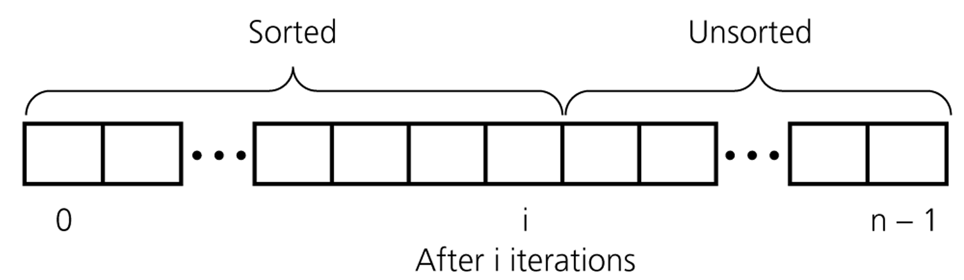
Insertion Sort contd.
An insertion sort partitions the array into two regions

Slide 131
Example of insertion sort
8
2
4
9
3
6

Slide 132
Example of Insertion Sort
8
2
4
9
3
6

Slide 133
Example of insertion sort
8
2
4
9
3
6
2
8
4
9
3
6

Slide 134
Example of insertion sort
8
2
4
9
3
6
2
8
4
9
3
6

Slide 135
Example of insertion sort
8
2
4
9
3
6
2
8
4
9
3
6
2
4
8
9
3
6

Slide 136
Example of insertion sort
8
2
4
9
3
6
2
8
4
9
3
6
2
4
8
9
3
6

Slide 137
Example of insertion sort
8
2
4
9
3
6
2
8
4
9
3
6
2
4
8
9
3
6
2
4
8
9
3
6

Slide 138
Example of Insertion Sort
8
2
4
9
3
6
2
8
4
9
3
6
2
4
8
9
3
6
2
4
8
9
3
6

Slide 139
Example of insertion sort
8
2
4
9
3
6
2
8
4
9
3
6
2
4
8
9
3
6
2
4
8
9
3
6
2
3
4
8
9
6

Slide 140
Example of insertion sort
8
2
4
9
3
6
2
8
4
9
3
6
2
4
8
9
3
6
2
4
8
9
3
6
2
3
4
8
9
6

Slide 141
Example of insertion sort
8
2
4
9
3
6
2
8
4
9
3
6
2
4
8
9
3
6
2
4
8
9
3
6
2
3
4
8
9
6
2
3
4
6
8
9
done

Slide 142
Insertion Sort Example
5 7 0 3 4 2 6 1 (0)
5 7 0 3 4 2 6 1 (0)
0 5 7 3 4 2 6 1 (2)
0 3 5 7 4 2 6 1 (2)
0 3 4 5 7 2 6 1 (2)
0 2 3 4 5 7 6 1 (4)
0 2 3 4 5 6 7 1 (1)
0 1 2 3 4 5 6 7 (6)

Slide 143
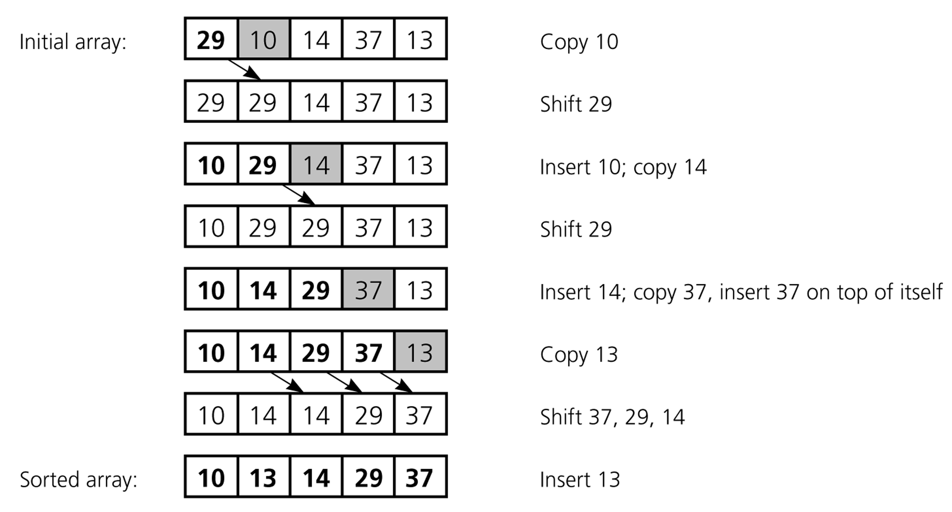
An insertion sort of an array of five integers

Slide 144
Insertion Sort Procedure
Do steps 2-4 for i= 1 upto n-1
Hold the element s
Locate the least index j for which s_{j} >= s_{i}
Shift the subsequence {s_{j} … s_{i-1}} up one position to {s_{j+1} … s_{i}}
Copy the held value of s_{i} into s_{j}

Slide 145
Insertion Sort algorithm
insertionSort(array)
mark first element as sorted
for each unsorted element X
‘hold' the element X
for j <- lastSortedIndex down to 0
if current element j > X
move sorted element to the right by 1
break loop and insert X here
end insertionSort

Slide 146
Insertion Sort Algorithm
void insertionSort(int[] a) {
for (int i = 1; i < SIZE; i++) {
int ai = a[i], j;
for (j = i; j > 0 && a[j-1] > ai; j--) {
a[j] = a[j–1];
}
a[j] = ai;
}
}

Slide 147
Insertion Sort: Number of Comparisons
# of Sorted Elements | Best case | Worst case
0 | 0 | 0
1 | 1 | 1
2 | 1 | 2
… | … | …
n-1 | 1 | n-1
 | n-1 | n(n-1)/2
If the sequence is nearly sorted, then insertion sort will run nearly in O(n) time.

Slide 148
Divide and Conquer Strategy

Slide 149
Divide-and-Conquer
Divide and Conquer is a method of algorithm design.
This method has three distinct steps:
Divide: If the input size is too large to deal with in a straightforward manner, divide the data into two or more disjoint subsets.
Recur: Use divide and conquer to solve the sub-problems associated with the data subsets.
Conquer: Take the solutions to the sub-problems and “merge” these solutions into a solution for the original problem.

Slide 150
Merge-Sort
Algorithm:
Divide
Recur: Recursive sort sequences S₁ and S₂.
Conquer: Put back the elements into S by merging the sorted sequences S₁ and S₂ into a unique sorted sequence.
Notes:
Divide: If S has at least two elements (nothing needs to be done if S has zero or one elements), remove all the elements from S and put them into two sequences, S₁ and S₂, each containing about half of the elements of S. (i.e. S₁ contains the first ⎡n/2⎤ elements and S₂ contains the remaining ⎣n/2⎦ elements.
Partition the n > 1 elements into two smaller instances.
First ceil(n/2) elements define one of the smaller instances; remaining floor(n/2) elements define the second smaller instance.
Each of the two smaller instances is sorted recursively.
The sorted smaller instances are combined using a process called merge.
Usually implemented non-recursively.

Slide 151
Merge-Sort Example

Slide 152
98
23
45
14
6
67
33
42
98
23
45
14
6
67
33
42

Slide 153
98
23
45
14
6
67
33
42
98
23
45
14
6
67
33
42
98
23
45
14

Slide 154
98
23
45
14
6
67
33
42
98
23
45
14
6
67
33
42
98
23
45
14
98
23

Slide 155
98
23
45
14
6
67
33
42
98
23
45
14
6
67
33
42
98
23
45
14
98
23
Merge

Slide 156
98
23
45
14
6
67
33
42
98
23
45
14
6
67
33
42
98
23
45
14
98
23
23
Merge

Slide 157
98
23
45
14
6
67
33
42
98
23
45
14
6
67
33
42
98
23
45
14
98
23
23
98
Merge

Slide 158
98
23
45
14
6
67
33
42
98
23
45
14
6
67
33
42
98
23
45
14
98
23
45
14
23
98

Slide 159
98
23
45
14
6
67
33
42
98
23
45
14
6
67
33
42
98
23
45
14
98
23
45
14
23
98
Merge

Slide 160
98
23
45
14
6
67
33
42
98
23
45
14
6
67
33
42
98
23
45
14
98
23
45
14
23
98
14
Merge

Slide 161
98
23
45
14
6
67
33
42
98
23
45
14
6
67
33
42
98
23
45
14
98
23
45
14
23
98
14
45
Merge

Slide 162
98
23
45
14
6
67
33
42
98
23
45
14
6
67
33
42
98
23
45
14
98
23
45
14
23
98
14
45
Merge

Slide 163
98
23
45
14
6
67
33
42
98
23
45
14
6
67
33
42
98
23
45
14
98
23
45
14
23
98
14
45
14
Merge

Slide 164
98
23
45
14
6
67
33
42
98
23
45
14
6
67
33
42
98
23
45
14
98
23
45
14
23
98
14
45
14
23
Merge

Slide 165
98
23
45
14
6
67
33
42
98
23
45
14
6
67
33
42
98
23
45
14
98
23
45
14
23
98
14
45
14
23
45
Merge

Slide 166
98
23
45
14
6
67
33
42
98
23
45
14
6
67
33
42
98
23
45
14
98
23
45
14
23
98
14
45
14
23
45
98
Merge

Slide 167
98
23
45
14
6
67
33
42
98
23
45
14
6
67
33
42
98
23
45
14
6
67
33
42
98
23
45
14
23
98
14
45
14
23
45
98

Slide 168
98
23
45
14
6
67
33
42
98
23
45
14
6
67
33
42
98
23
45
14
6
67
33
42
98
23
45
14
6
67
23
98
14
45
14
23
45
98

Slide 169
98
23
45
14
6
67
33
42
98
23
45
14
6
67
33
42
98
23
45
14
6
67
33
42
98
23
45
14
6
67
23
98
14
45
14
23
45
98
Merge

Slide 170
98
23
45
14
6
67
33
42
98
23
45
14
6
67
33
42
98
23
45
14
6
67
33
42
98
23
45
14
6
67
23
98
14
45
6
14
23
45
98
Merge

Slide 171
98
23
45
14
6
67
33
42
98
23
45
14
6
67
33
42
98
23
45
14
6
67
33
42
98
23
45
14
6
67
23
98
14
45
6
67
14
23
45
98
Merge

Slide 172
98
23
45
14
6
67
33
42
98
23
45
14
6
67
33
42
98
23
45
14
6
67
33
42
98
23
45
14
6
67
33
42
23
98
14
45
6
67
14
23
45
98

Slide 173
98
23
45
14
6
67
33
42
98
23
45
14
6
67
33
42
98
23
45
14
6
67
33
42
98
23
45
14
6
67
33
42
23
98
14
45
6
67
14
23
45
98
Merge

Slide 174
98
23
45
14
6
67
33
42
98
23
45
14
6
67
33
42
98
23
45
14
6
67
33
42
98
23
45
14
6
67
33
42
23
98
14
45
6
67
33
14
23
45
98
Merge

Slide 175
98
23
45
14
6
67
33
42
98
23
45
14
6
67
33
42
98
23
45
14
6
67
33
42
98
23
45
14
6
67
33
42
23
98
14
45
6
67
33
42
14
23
45
98
Merge

Slide 176
98
23
45
14
6
67
33
42
98
23
45
14
6
67
33
42
98
23
45
14
6
67
33
42
98
23
45
14
6
67
33
42
23
98
14
45
6
67
33
42
14
23
45
98
Merge

Slide 177
98
23
45
14
6
67
33
42
98
23
45
14
6
67
33
42
98
23
45
14
6
67
33
42
98
23
45
14
6
67
33
42
23
98
14
45
6
67
33
42
14
23
45
98
6
Merge

Slide 178
98
23
45
14
6
67
33
42
98
23
45
14
6
67
33
42
98
23
45
14
6
67
33
42
98
23
45
14
6
67
33
42
23
98
14
45
6
67
33
42
14
23
45
98
6
33
Merge

Slide 179
98
23
45
14
6
67
33
42
98
23
45
14
6
67
33
42
98
23
45
14
6
67
33
42
98
23
45
14
6
67
33
42
23
98
14
45
6
67
33
42
14
23
45
98
6
33
42
Merge

Slide 180
98
23
45
14
6
67
33
42
98
23
45
14
6
67
33
42
98
23
45
14
6
67
33
42
98
23
45
14
6
67
33
42
23
98
14
45
6
67
33
42
14
23
45
98
6
33
42
67
Merge

Slide 181
98
23
45
14
6
67
33
42
98
23
45
14
6
67
33
42
98
23
45
14
6
67
33
42
98
23
45
14
6
67
33
42
23
98
14
45
6
67
33
42
14
23
45
98
6
33
42
67
Merge

Slide 182
98
23
45
14
6
67
33
42
98
23
45
14
6
67
33
42
98
23
45
14
6
67
33
42
98
23
45
14
6
67
33
42
23
98
14
45
6
67
33
42
14
23
45
98
6
33
42
67
6
Merge

Slide 183
98
23
45
14
6
67
33
42
98
23
45
14
6
67
33
42
98
23
45
14
6
67
33
42
98
23
45
14
6
67
33
42
23
98
14
45
6
67
33
42
14
23
45
98
6
33
42
67
6
14
Merge

Slide 184
98
23
45
14
6
67
33
42
98
23
45
14
6
67
33
42
98
23
45
14
6
67
33
42
98
23
45
14
6
67
33
42
23
98
14
45
6
67
33
42
14
23
45
98
6
33
42
67
6
14
23
Merge

Slide 185
98
23
45
14
6
67
33
42
98
23
45
14
6
67
33
42
98
23
45
14
6
67
33
42
98
23
45
14
6
67
33
42
23
98
14
45
6
67
33
42
14
23
45
98
6
33
42
67
6
14
23
33
Merge

Slide 186
98
23
45
14
6
67
33
42
98
23
45
14
6
67
33
42
98
23
45
14
6
67
33
42
98
23
45
14
6
67
33
42
23
98
14
45
6
67
33
42
14
23
45
98
6
33
42
67
6
14
23
33
42
Merge

Slide 187
98
23
45
14
6
67
33
42
98
23
45
14
6
67
33
42
98
23
45
14
6
67
33
42
98
23
45
14
6
67
33
42
23
98
14
45
6
67
33
42
14
23
45
98
6
33
42
67
6
14
23
33
42
45
Merge

Slide 188
98
23
45
14
6
67
33
42
98
23
45
14
6
67
33
42
98
23
45
14
6
67
33
42
98
23
45
14
6
67
33
42
23
98
14
45
6
67
33
42
14
23
45
98
6
33
42
67
6
14
23
33
42
45
67
Merge

Slide 189
98
23
45
14
6
67
33
42
98
23
45
14
6
67
33
42
98
23
45
14
6
67
33
42
98
23
45
14
6
67
33
42
23
98
14
45
6
67
33
42
14
23
45
98
6
33
42
67
6
14
23
33
42
45
67
98
Merge

Slide 190
98
23
45
14
6
67
33
42
98
23
45
14
6
67
33
42
98
23
45
14
6
67
33
42
98
23
45
14
6
67
33
42
23
98
14
45
6
67
33
42
14
23
45
98
6
33
42
67
6
14
23
33
42
45
67
98

Slide 191
98
23
45
14
6
67
33
42
6
14
23
33
42
45
67
98

Slide 192
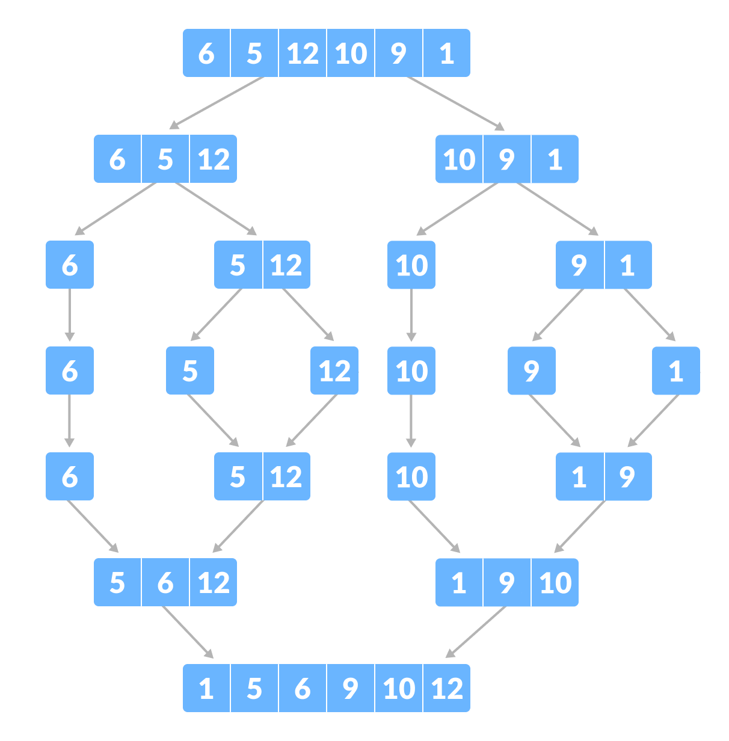
example

Slide 193
Merge Sort Algorithm
Overview:
Split array into two halves
Sort the left half (recursively)
Sort the right half (recursively)
Merge the two sorted halves

Slide 194
Merge Sort Procedure
If q-p > 1 do steps 2-5 (i.e. p < q)
Split s into 2 subsequences, a = {s_{p} … s_{m-1}} and b = {s_{m} … s_{q-1}}, where m = (p + q) / 2
Sort a
Sort b
Merge a and b back into s, preserving order

Slide 195
Merge Sort Algorithm
void sort(int a[],int p, int q)
{
if (p > q)
return;
int m = (p + q) / 2;
sort(a, p, m);
sort(a, m+1, q);
merge (a, p, m, q);
}
Call from main
sort (a, 0, n-1)

Slide 196
Merge function
void merge(int arr[], int low, int mid, int high)
{
int i, m, k, l, temp[MAX];
l=low;
i=low;
m=mid+1;
while((l<=mid)&&(m<=high))
{
if(arr[l]<=arr[m])
{
temp[i]=arr[l];
l++;
}
else
{
temp[i]=arr[m];
m++;
}
i++;
}

Slide 197
Merge function contd.
if(l>mid)
{
for(k=m;k<=high;k++)
{
temp[i]=arr[k];
i++;
}
}
else
{
for(k=l;k<=mid;k++)
{
temp[i]=arr[k];
i++;
}
}
for(k=low;k<=high;k++)
{
arr[k]=temp[k];
}
}

Slide 198
Running Time of Merge-Sort
At each level in the binary tree created for Merge Sort, there are n elements, with O(1) time spent at each element
→ O(n) running time for processing one level
The height of the tree is O(log n)
Therefore, the time complexity is O(nlog n)

Slide 199
Quick-Sort
1) Divide : If the sequence S has 2 or more elements, select an element x from S to be your pivot. Any arbitrary element, like the last, will do. Remove all the elements of S and divide them into 3 sequences:
L, holds S’s elements less than x
E, holds S’s elements equal to x
G, holds S’s elements greater than x
2) Recurse: Recursively sort L and G
3) Conquer: Finally, to put elements back into S in order, first inserts the elements of L, then those of E, and those of G.

Slide 200
Idea of Quick Sort
1) Select: pick an element
2) Divide: rearrange elements so that x goes to its final position E
3) Recurse and Conquer: recursively sort

Slide 201
Quick-Sort Tree

Slide 202
In-Place Quick-Sort
Divide step: l scans the sequence from the left, and r from the right.
A swap is performed when l is at an element larger than the pivot and r is at one smaller than the pivot.

Slide 203
In Place Quick Sort (cont’d)
A final swap with the pivot completes the divide step
https://www.youtube.com/watch?v=-2VqW516BcI

Slide 204
Quick Sort Procedure / Algorithm
If q-p > 1 do steps 2-5 (i.e. p < q)
Apply partition algorithm and
obtain pivot index m
Apply quick sort to {s₀ … s_{m-1}}
Apply quick sort to {s_{m+1} … s_{n-1}}

Slide 205
Quick Sort Procedure / Algorithm
void sort(int a[],int p, int q) {
if (q-p < 2)
{
return;
}
int m = partition(a, p, q) ;
sort(a, p, m-1);
sort(a, m+1, q);
}
Call from main
sort (a, 0, n-1)

Slide 206
Partition Algorithm
int partition(int a[], int p, int q)
{
int pivot = a[p], i = p, j = q;
while (i < j)
{
while (i < j && a[--j] >= pivot) ;
if(i < j)
a[i] = a[j];
while (i < j && a[++i] <= pivot) ;
if(i < j)
a[j] = a[i];
}
a[j] = pivot;
return j;
}

Slide 207
Why study Heapsort?
Heapsort is always O(n log n)
Quicksort is usually O(n log n) but in the worst case slows to O(n²)
Notes:
Quicksort is generally faster, but Heapsort is better in time-critical applications

Slide 208
What is a “heap”?
A balanced, left-justified binary tree in which no node has a value greater than the value in its parent
Notes:
These two definitions have little in common Heapsort uses the second definition

Slide 209
Balanced binary trees
The depth of a node is its distance from the root
The depth of a tree is the depth of the deepest node
A binary tree of depth n is balanced if all the nodes at depths 0 through n-2 have two children
n-2
n-1
n
Balanced
Balanced
Not balanced

Slide 210
Left-justified binary trees
A balanced binary tree of depth n is left-justified if:
it has 2^{n} nodes at depth n (the tree is “full”)
or
it has 2^{k} nodes at depth k, for all k < n, and all the leaves at depth n are as far left as possible
Left-justified
Not left-justified

Slide 211
Approach: Heap Sort
Top down
Bottom up
First, we will learn how to turn a binary tree into a heap
Next, we will learn how to turn a binary tree back into a heap after it has been changed in a certain way
Finally, we will see how to use these ideas to sort an array
Notes:
First, we will learn how to turn a binary tree into a heap
Next, we will learn how to turn a binary tree back into a heap after it has been changed in a certain way
Finally (this is the cool part) we will see how to use these ideas to sort an array

Slide 212
The heap property
12
12
12
8
3
8
12
8
14
A node has the heap property if the value in the node is larger than the values in its children
All leaf nodes automatically have the heap property
A binary tree is a heap if all nodes in it have the heap property
Blue node has heap property
Blue node has heap property
Blue node does not have heap property

Slide 213
siftUp
12
14
8
14
8
12
Given a node that does not have the heap property, you can give it the heap property by exchanging its value with the value of the larger child
This is sometimes called sifting up
Blue node does not have heap property
Blue node has heap property
Notes:
Notice that the child may have lost the heap property

Slide 214
Constructing a heap I
A tree consisting of a single node is automatically a heap
We construct a heap by adding nodes one at a time:
Add the node just to the right of the rightmost node in the deepest level
If the deepest level is full, start a new level
Examples:
Add a new node here
Add a new node here

Slide 215
Constructing a heap II
Each time we add a node, we may destroy the heap property of its parent node
To fix this, we sift up
But each time we sift up, the value of the topmost node in the sift may increase, and this may destroy the heap property of its parent node
We repeat the sifting up process, moving up in the tree, until either
We reach nodes whose values don’t need to be swapped (because the parent is still larger than both children), or
We reach the root

Slide 216
Constructing a heap III
8
8
10
10
10
8
8
5
1
2
3
10
10
12
8
5
12
5
10
5
12
8
8
4

Slide 217
Other children are not affected
12
12
14
10
5
14
5
12
5
The node containing 8 is not affected because its parent gets larger, not smaller
The node containing 5 is not affected because its parent gets larger, not smaller
The node containing 8 is still not affected because, although its parent got smaller, its parent is still greater than it was originally
8
14
8
10
8
10

Slide 218
A sample heap
Here’s a sample binary tree after it has been heapified
Notice that heapified does not mean sorted
Heapifying does not change the shape of the binary tree; this binary tree is balanced and left-justified
25
22
17
19
22
14
15
18
14
21
3
9
11

Slide 219
Removing the root
Notice that the largest number is now in the root
Suppose we discard the root:
How can we fix the binary tree so it is once again balanced and left-justified?
Solution: remove the rightmost leaf at the deepest level and use it for the new root
11
22
17
19
22
14
15
18
14
21
3
9
11

Slide 220
The reHeap method
Our tree is balanced and left-justified, but no longer a heap
However, only the root lacks the heap property
We can siftUp() the root
After doing this, one and only one of its children may have lost the heap property
11
22
17
19
22
14
15
18
14
21
3
9

Slide 221
The reHeap method contd
Now the left child of the root (still the number 11) lacks the heap property
We can siftUp() this node
After doing this, one and only one of its children may have lost the heap property
22
11
17
19
22
14
15
18
14
21
3
9

Slide 222
The reHeap method contd.
Now the right child of the left child of the root (still the number 11) lacks the heap property:
We can siftUp() this node
After doing this, one and only one of its children may have lost the heap property —but it doesn’t, because it’s a leaf
22
22
17
19
11
14
15
18
14
21
3
9

Slide 223
The reHeap method contd.
22
Our tree is once again a heap, because every node in it has the heap property
Once again, the largest value is in the root
We can repeat this process until the tree becomes empty
This produces a sequence of values in order largest to smallest
22
17
19
21
14
15
18
14
11
3
9

Slide 224
Sorting
What do heaps have to do with sorting an array?
Because the binary tree is balanced and left justified, it can be represented as an array
All our operations on binary trees can be represented as operations on arrays
To sort:
heapify the array;
while the array isn’t empty {
remove and replace the root;
reheap the new root node; }
Notes:
Here’s the neat part:

Slide 225
Mapping into an array
25
22
17
19
22
14
15
18
14
21
3
9
11
0 1 2 3 4 5 6 7 8 9 10 11 12
The left child of index i is at index 2*i+1
The right child of index i is at index 2*i+2
Example: the children of node 3 (19) are 7 (18) and 8 (14)
25
22
17
19
22
14
15
18
14
21
3
9
11

Slide 226
Removing and replacing the root
0 1 2 3 4 5 6 7 8 9 10 11 12
25
22
17
19
22
14
15
18
14
21
3
9
11
The “root” is the first element in the array
The “rightmost node at the deepest level” is the last element
Swap them and pretend that the last element in the array no longer exists—that is, the “last index” is 11 (containing the value 9)
0 1 2 3 4 5 6 7 8 9 10 11 12
11
22
17
19
22
14
15
18
14
21
3
9
25

Slide 227
Reheap and repeat
0 1 2 3 4 5 6 7 8 9 10 11 12
11
22
17
19
22
14
15
18
14
21
3
9
25
0 1 2 3 4 5 6 7 8 9 10 11 12
22
22
17
19
21
14
15
18
14
11
3
9
25
Reheap the root node (index 0, containing 11) And again, remove and replace the root node
Remember, though, that the “last” array index is changed
Repeat until the last becomes first, and the array is sorted!
0 1 2 3 4 5 6 7 8 9 10 11 12
9
22
17
19
22
14
15
18
14
21
3
22
25

Slide 228
code
void heapsort()
{
buildheap();
while (n>1)
{
n--;
exchange (0, n);
downheap (0);
}
}
void buildheap()
{
for (int v=n/2-1; v>=0; v--)
downheap (v);
}

Slide 229
Code contd.
void downheap (int v)
{
int w=2*v+1; // first descendant of v
while (w<n)
{
if (w+1<n) // is there a second descendant?
if (a[w+1]>a[w]) w++;
if (a[v]>=a[w]) return; // v has heap property
// else
exchange(v, w);
v=w; // continue
w=2*v+1;
}
}

Slide 230
Analysis I
Here’s how the algorithm starts:
heapify the array;
Heapifying the array: we add each of n nodes
Each node has to be sifted up, possibly as far as the root
Since the binary tree is perfectly balanced, sifting up a single node takes O(log n) time
Since we do this n times, heapifying takes n*O(log n) time, that is, O(n log n) time

Slide 231
Analysis II
Rest of the algorithm:
while the array isn’t empty {
remove and replace the root;
reheap the new root node; }
We do the while loop n times (actually, n-1 times), because we remove one of the n nodes each time
Removing and replacing the root takes O(1) time
Therefore, the total time is n times however long it takes the reheap method

Slide 232
Analysis III
To reheap the root node, we have to follow one path from the root to a leaf node (and we might stop before we reach a leaf)
The binary tree is perfectly balanced
Therefore, this path is O(log n) long
And we only do O(1) operations at each node
Therefore, reheaping takes O(log n) times
Since we reheap inside a while loop that we do n times, the total time for the while loop is n*O(log n), or O(n log n)

Slide 233
Analysis IV
Here’s the algorithm again:
heapify the array;
while the array isn’t empty {
remove and replace the root;
reheap the new root node; }
We have seen that heapifying takes O(n log n) time
The while loop takes O(n log n) time
The total time is therefore O(n log n) + O(n log n)
This is the same as O(n log n) time

Slide 234
Classification of Sorting algorithms
Comparison sorts
Bubble sort
Insertion sort
Selection sort
Shell sort
Merge sort
Quick sort
Heap sort
Non-comparion sorts (LINEAR TIME)
Count Sort
Radix sort
Bucket Sort
Notes:
(examines individual bits of keys)
Bucket sort (examines bits of keys)
Counting sort (indexes using key values)

Slide 235
How Fast Can We Sort?
Selection Sort, Bubble Sort, Insertion Sort:
Heap Sort, Merge sort:
Quicksort:
What is common to all these algorithms?
Make comparisons between input elements
a_{i} < a_{j}, a_{i} ≤ a_{j}, a_{i} = a_{j}, a_{i} ≥ a_{j}, or a_{i} > a_{j}
O(n²)
O(nlogn)
O(nlogn) - average

Slide 236
Radix Sort
Radix is the base of a number system.
Radix sort is a multiple pass distribution sort.
Radix sort uses bucket sort as the stable sorting algorithm, where the initial relative order of equal keys is unchanged

Slide 237
Radix Sort
ASCII (r = 26)
Decimal (r = 10)
Bit String (r = 2)
Octal (r = 8)
Hexadecimal (r = 16)
Notes:
Lexicographic Array of constant size
Width of lexicographic array (Example: ISBN; d=10)

Slide 238
Radix Sort Example
Input data:
a
b
a
b
a
c
c
a
a
a
c
b
b
a
b
c
c
a
a
a
c
b
b
a

Slide 239
Radix Sort Example
Pass 1: Looking at rightmost position.
a
b
a
b
a
c
c
a
a
a
c
b
b
a
b
c
c
a
a
a
c
b
b
a
Place into appropriate pile.
a
b
c

Slide 240
Radix Sort Example
Pass 1: Looking at rightmost position.
a
b
a
b
a
c
c
a
a
a
c
b
b
a
b
c
c
a
a
a
c
b
b
a
b
b
a
Join piles.
c
c
a
c
a
a
b
a
b
a
a
c
a
b
a
a
c
b
b
a
c
a
b
c

Slide 241
Radix Sort Example
Pass 2: Looking at next position.
a
b
a
c
a
a
c
c
a
b
b
a
a
c
b
b
a
b
b
a
c
a
a
c
Place into appropriate pile.
a
b
c

Slide 242
Radix Sort Example
Pass 2: Looking at next position.
a
b
a
c
a
a
c
c
a
b
b
a
a
c
b
b
a
b
b
a
c
a
a
c
a
a
c
Join piles.
b
a
c
b
a
b
b
b
a
a
c
b
c
a
a
a
b
a
c
c
a
a
b
c

Slide 243
Radix Sort Example
Pass 3: Looking at last position.
c
a
a
b
a
b
b
a
c
a
a
c
a
b
a
b
b
a
c
c
a
a
c
b
Place into appropriate pile.
a
b
c

Slide 244
Radix Sort Example
Pass 3: Looking at last position.
c
a
a
b
a
b
b
a
c
a
a
c
a
b
a
b
b
a
c
c
a
a
c
b
Join piles.
a
c
b
b
b
a
a
b
a
b
a
c
c
c
a
a
a
c
b
a
b
c
a
a
a
b
c

Slide 245
Radix Sort Example
Result is sorted.
a
a
c
a
b
a
a
c
b
b
a
b
b
a
c
b
b
a
c
a
a
c
c
a

Slide 246
Classification of Radix Sort
Radix sort is classified based on how it works internally:
least significant digit (LSD) radix sort
most significant digit (MSD) radix sort

Slide 247
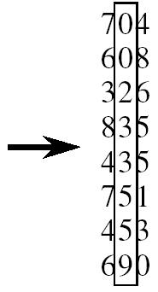

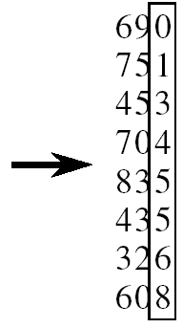
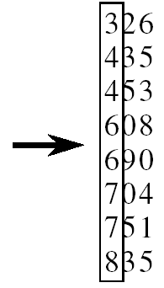

RADIX-SORT Contd.

Slide 248
Radix Sort Example
Least-significant-digit-first
Example: 275, 087, 426, 061, 509, 170, 677, 503

Slide 249
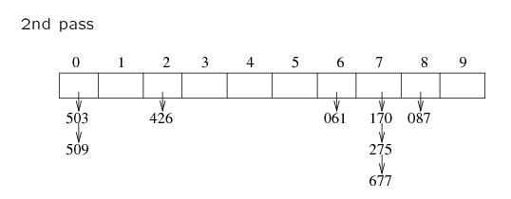
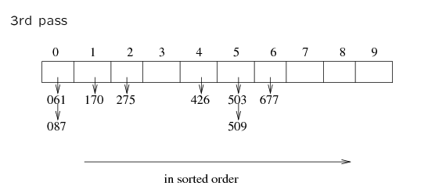
Radix Sort Contd.

Slide 250
Example for LSD Radix Sort
d (digit) = 3, r (radix) = 10 ascending order
179, 208, 306, 93, 859, 984, 55, 9, 271, 33
271, 93, 33, 984, 55, 306, 208, 179, 859, 9 After the first pass

Slide 251
front[0]
306
208
9
null
rear[0]
front[1]
null
rear[1]
front[2]
null
rear[2]
front[3]
33
null
rear[3]
front[4]
null
rear[4]
front[5]
55
859
null
rear[5]
front[6]
null
rear[6]
front[7]
271
179
null
rear[7]
front[8]
984
null
rear[8]
front[9]
93
null
306, 208, 9, 33, 55, 859, 271, 179, 984, 93 (second pass)
rear[9]

Slide 252
front[0]
9
33
55
93
null
rear[0]
front[1]
179
null
rear[1]
front[2]
208
271
null
rear[2]
front[3]
306
null
rear[3]
front[4]
null
rear[4]
front[5]
null
rear[5]
front[6]
null
rear[6]
front[7]
null
rear[7]
front[8]
859
null
rear[8]
front[9]
984
null
9, 33, 55, 93, 179, 208, 271, 306, 859, 984 (third pass)
rear[9]

Slide 253
Radix Sort
Every integer can be represented by at most k digits
d₁d₂…d_{k} where d_{i} are digits in base r
d₁: most significant digit
d_{k}: least significant digit

Slide 254
Radix Sort Contd.
Algorithm
sort by the least significant digit first
=> Numbers with the same digit go to same bin
reorder all the numbers: the numbers in bin 0 precede the numbers in bin 1, which precede the numbers in bin 2, and so on
sort by the next least significant digit
continue this process until the numbers have been sorted on all k digits

Slide 255
Steps / Procedure
For k=1 to number of digits do steps 2 and 3
For i=0 to n-1 do
Temp=x[i]
d = kth digit of temp
Place temp at rear of Q[d]
For j=0 to 9 do
delete elements of Q[j] and place in next sequential position of queue x

Slide 256
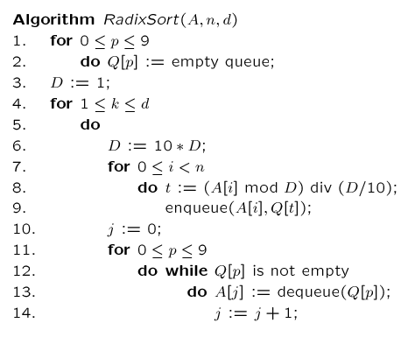
Algorithm
// base 10
// FIFO
// d times of counting sort
// scan A[i], put into correct slot
// re-order back to original array

Slide 257
Comparison of sorting algorithms
Algorithm | Average | Worst case | Space usage
Selection | n² | n² | In place
Bubble | n² | n² | In place
Insertion | n² | n² | In place
Merge | O(nlog₂n) | O(nlog₂n) | Extra n entries
Quick | O(nlog₂n) | O(n²) | In place
Heap | O(nlog₂n) | O(nlog₂n) | In place
Radix | O(m + n) | O(m + n) | Extra space for links

Slide 258
Why do we need hashing?
Many applications deal with lots of data
Search engines and web pages
There are myriad look ups.
The look ups are time critical.
Typical data structures like arrays and lists, may not be sufficient to handle efficient lookups
In general: When look-ups need to occur in near constant time.
A better way to maintain a table (Example: a Dictionary) that is easy to insert and search in O(1)

Slide 259
Hash Tables: Concept
0
 | ⁞
size -1
A hash table is an array of some fixed size
Basic idea:
The goal:
Aim for constant-time find, insert, and delete "on average" under reasonable assumptions
hash function:
index = h(key)
key space (e.g., integers, strings)

Slide 260
Examples: Integer
0
1
2
3
4
5
6
7
8
9
key space = integers
Table Size = 6
h(K) = K mod 6
Insert: 7, 18, 41, 94
Insert 12
0
1
2
3
4
5
key space = integers
Table Size = 10
h(K) = K mod 10
Insert: 7, 18, 41, 94
Notes:
7 (6*1 = 6)->1, 18-> 0, 41(6*6=36) -> 5, 34 (5*6)=30-> 4
Q: Why don’t we just create a table of size 100, or 40 and just map them directly to location?
A: Assumption is key space is much larger than the number of values we have to insert. (Ex. Using social security # as the key to put students in this class in a hash table. Table of size 999,999,999??)
Q: How long does that take to insert? O(1)
Q: How do we find them?
Q: How long does that take?
Q: What if we insert 12? (It wants to go in location 0 – CONFLICT)

Slide 261
Hash Function
Simple/fast to compute
Avoid collisions: Rarely hashes two keys to the same index
Zero collisions often impossible in theory but reasonably achievable in practice
Have keys distributed evenly among cells
It is a good idea to pick a prime as the table size to have a better distribution of values

Slide 262
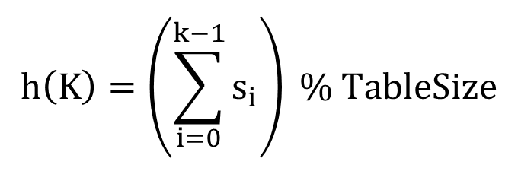

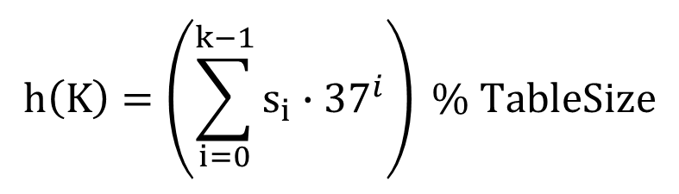
Sample Hash Function: Strings
key space = strings
s = s₀ s₁ s₂ … s_{k-1}
$$h\left(K\right)=\left(s_{0}\right) \% TableSize$$
$$h\left(K\right)=\left(\sum_{i=0}^{k−1}{s_{i}}\right) \% TableSize$$
$$h\left(K\right)=\left(\sum_{i=0}^{k−1}{s_{i}∙{37}^{i}}\right) \% TableSize$$

Slide 263
Example: Strings
Assume that N = 5 and the values we need to insert are: cab, bea, bad etc.
Let a=0, b=1, c=2, etc.
Define H such that H[data] = (Sum of characters) Mod N
H[cab] = (2+0+1) Mod 5 = 3
H[bea] = (1+4+0) Mod 5 = 0
H[bad] = (1+0+3) Mod 5 = 4

Slide 264
Collisions
What if the values we need to insert are “abc”, “cba”, “bca” etc.
When collisions occur, we need to “handle” them
Collisions can be reduced with a selection of a good hash function
Bad hash function:
Think of hashing 10000, 5-letter words into a table of size 10000 using the map H defined as
Good hash function:
Notes:
GOOD HASH FUNCTIN:
Suppose we need to hash a set of strings S ={Si} to a table of size N
H(Si) = (Σ Si[j].dj ) mod N, where Si[j] is the jth character of string Si
How expensive is to compute this function?
• cost with direct calculation
• Is it always possible to do direct calculation?
Is there a cheaper way to calculate this? Hint:
use Horners Rule.
public static int hash(String key, int n){
int value = 0;
for (int i=0; i<key.length(); i++)
value = (value*128+ key.charAt(i))%n;
return value;
}

Slide 265
Collision Avoidance
With (x%TableSize), number of collisions depends on the integers inserted and the TableSize
Larger table-size tends to help, but not always
Example: 70, 24, 56, 43, 10 with TableSize = 10 and TableSize = 60

Slide 266
Collision Avoidance contd.
Technique: Pick table size to be prime
Real-life data tends to have a pattern
"Multiples of 61" are probably less likely than "multiples of 60"
Some collision strategies do better with prime size
Example: data stored in hash table: 7160, 493, 60, 55, 321, 900, 810
tableSize = 10
data hashes to 0, 3, 0, 5, 1, 0, 0
tableSize = 11
data hashes to 10, 9, 5, 0, 2, 9, 7

Slide 267
Collision Resolution Techniques
There are two broad ways of collision resolution:
1. Separate Chaining: An array of linked list implementation.
2. Open Addressing: Array-based implementation.
(i) Linear probing (linear search)
(ii) Quadratic probing (nonlinear search)
(iii) Double hashing (uses two hash functions)

Slide 268
Separate Chaining
0 | /
1 | /
2 | /
3 | /
4 | /
5 | /
6 | /
7 | /
8 | /
9 | /
All keys that map to the same table location are kept in a linked list
Example: insert 10, 22, 86, 12, 42 with h(x) = x % 10

Slide 269
Separate Chaining Contd. (10, 22, 86, 12, 42)
0
1 | /
2 | /
3 | /
4 | /
5 | /
6 | /
7 | /
8 | /
9 | /
10
/
0
1 | /
2
3 | /
4 | /
5 | /
6 | /
7 | /
8 | /
9 | /
10
/
0
1 | /
2
3 | /
4 | /
5 | /
6
7 | /
8 | /
9 | /
10
/
22
/
22
/
86
/

Slide 270
Separate Chaining Contd. (10, 22, 86, 12, 42)
0
1 | /
2
3 | /
4 | /
5 | /
6
7 | /
8 | /
9 | /
10
/
0
1 | /
2
3 | /
4 | /
5 | /
6
7 | /
8 | /
9 | /
10
/
12
22
/
42
12
22
/
86
/
86
/

Slide 271
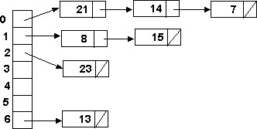
Example
Load the keys 23, 13, 21, 14, 7, 8, and 15 , in this order, in a hash table of size 7 using separate chaining with the hash function: h(key) = key % 7
h(23) = 23 % 7 = 2
h(13) = 13 % 7 = 6
h(21) = 21 % 7 = 0
h(14) = 14 % 7 = 0 collision
h(7) = 7 % 7 = 0 collision
h(8) = 8 % 7 = 1
h(15) = 15 % 7 = 1 collision

Slide 272
Separate Chaining with String Keys
Use the hash function hash to load (onion, salt, orange, tomato, cabbage, carrot, potato, Banana, Olive, etc.) into a hash table of size 13.
hash(onion) = (111 + 110 + 105 + 111 + 110) % 13 = 547 % 13 = 1
hash(salt) = (115 + 97 + 108 + 116) % 13 = 436 % 13 = 7
hash(orange) = (111 + 114 + 97 + 110 + 103 + 101)%13 = 636 %13 = 12

Slide 273
0
1
2
3
4
5
6
7
8
9
10
11
12
okra
potato
onion
carrot
cabbage
mushroom
salt
cucumber
tomato
mellon
olive
banana
orange

Slide 274
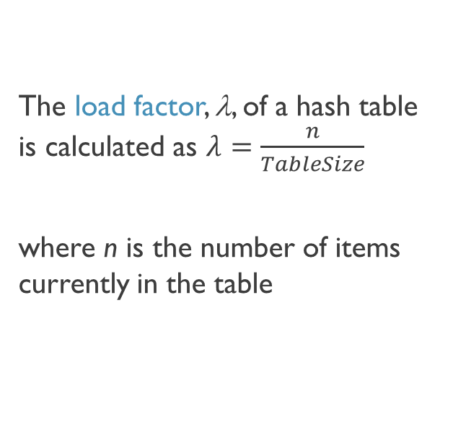

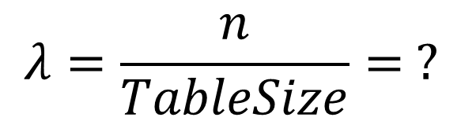
Load Factor
0
1 | /
2
3 | /
4 | /
5 | /
6
7 | /
8 | /
9 | /
10
/
The load factor, λ, of a hash table is calculated as $λ=\frac{n}{TableSize}$
where n is the number of items currently in the table
42
12
22
/
86
/
$$λ=\frac{n}{TableSize}= ?$$
$$=\frac{5}{10}=0.5$$

Slide 275
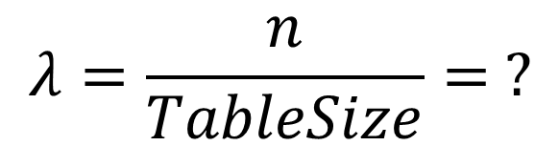

Load Factor Contd.
0
1
2
3
4 | /
5
6
7
8
9
10
/
AIM: to keep λ around 1 for separate chaining
71
2
31
/
42
12
22
/
63
73
/
75
5
65
95
/
86
/
27
47
88
18
38
98
/
99
/
$$λ=\frac{n}{TableSize}= ?$$
$$=\frac{21}{10}=2.1$$

Slide 276
Open Addressing
Separate chaining does not use all the space in the table. Why not use it?
Store directly in the array cell
No linked lists or buckets
Open addressing means resolving collisions by trying a sequence of other positions in the table
For a given hash function h(key), the only difference in the open addressing collision resolution techniques (linear probing, quadratic probing and double hashing) is in the definition of the function c(i).
Common definitions of c(i) are:

Slide 277
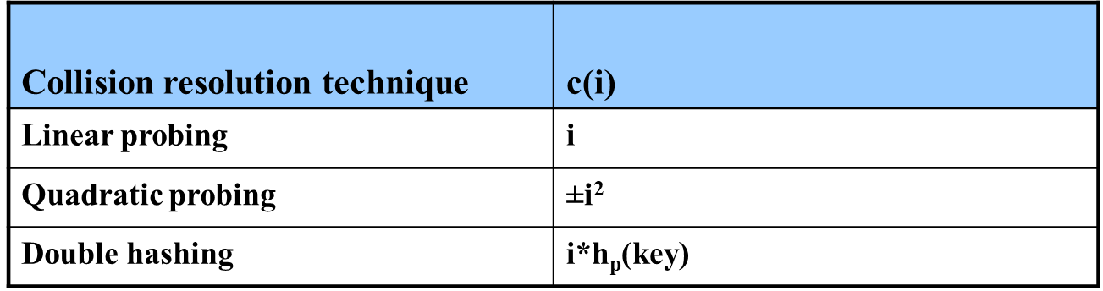
Open Addressing Contd.
Common definitions of c(i) are: where hp(key) is another hash function

Slide 278
Open Addressing Contd.
Advantages of Open addressing:
All items are stored in the hash table itself. There is no need for another data structure.
Open addressing is more efficient storage-wise.
Disadvantages of Open Addressing:
The keys of the objects to be hashed must be distinct.
Dependent on choosing a proper table size.
Requires the use of a three-state (Occupied, Empty, or Deleted) flag in each cell.

Slide 279
Open Addressing: Linear Probing
Trying the next spot is called probing: Linear probing: (h(key) + i) % TableSize
How to deal with collisions?
If h(key) is already full, try (h(key) + 1) % TableSize
If full, try (h(key) + 2) % TableSize
If full, try (h(key) + 3) % TableSize
If full…

Slide 280
Open Addressing: Linear Probing (insert 38, 19, 8, 79, 10)
0
1
2
3
4
5
6
7
8 | 38
9
0
1
2
3
4
5
6
7
8
9
0
1
2
3
4
5
6
7
8 | 38
9 | 19
0 | 8
1
2
3
4
5
6
7
8 | 38
9 | 19
0 | 8
1 | 79
2
3
4
5
6
7
8 | 38
9 | 19
0 | 8
1 | 79
2 | 10
3
4
5
6
7
8 | 38
9 | 19

Slide 281
Open Addressing: Other Operations
In addition to the cell data (if any), each cell keeps one of the three states: EMPTY, OCCUPIED, DELETED.
While inserting, if a collision occurs, alternative cells are tried until an empty cell is found.
Deletion: (lazy deletion): When a key is deleted the slot is marked as DELETED rather than EMPTY otherwise subsequent searches that hash at the deleted cell will fail.
Probe sequence: A probe sequence is the sequence of array indexes that is followed in searching for an empty cell during an insertion, or in searching for a key during find or delete operations.

Slide 282
Open Addressing: Other Operations
insert finds an open table position using a probe function
find?
Must use same probe function to "retrace the trail" for the data
Unsuccessful search when reach empty position
delete?
"lazy" deletion (Just mark the items as inactive rather than removing it.)
Marker indicates "data was here, keep on probing"
10 | ✗ | / | 23 | / | / | 16 | ✗ | 26

Slide 283
Lazy delete example
Naïve removal can leave gaps!
Clever removal

Slide 284
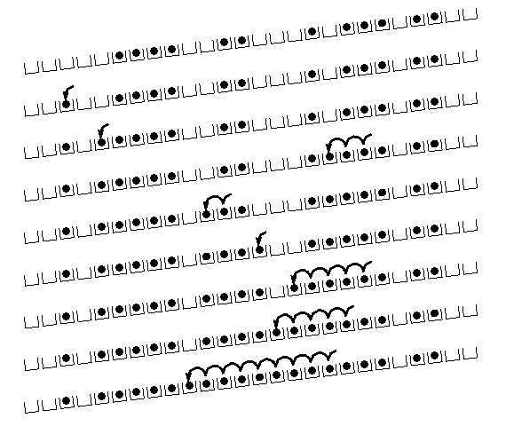
Linear Probing: Clustering
no collision
collision in small cluster
no collision
collision in large cluster
[R. Sedgewick]

Slide 285
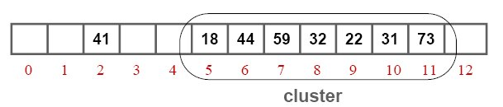
Linear Probing: Clustering Contd.
Example of a primary cluster: Insert keys: 18, 41, 22, 44, 59, 32, 31, 73, in this order, in an originally empty hash table of size 13, using the hash function h(key) = key % 13 and c(i) = i:
h(18) = 5
h(41) = 2
h(22) = 9
h(44) = 5+1
h(59) = 7
h(32) = 6+1+1
h(31) = 5+1+1+1+1+1
h(73) = 8+1+1+1

Slide 286
Linear Probing: Example
Example: Perform the operations given below, in the given order, on an initially empty hash table of size 13 using linear probing with c(i) = i and the hash function: h(key) = key % 13:
insert(18), insert(26), insert(35), insert(9), find(15), find(48), delete(35), delete(40), find(9), insert(64), insert(47), find(35)
The required probe sequences are given by:
h_{i}(key) = (h(key) + i) % 13 i = 0, 1, 2, . . ., 12

Slide 287
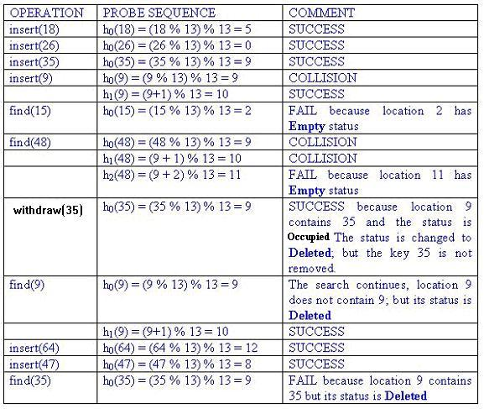
Index | Status | Value
0 | O | 26
1 | E
2 | E
3 | E
4 | E
5 | O | 18
6 | E
7 | E
8 | O | 47
9 | D | 35
10 | O | 9
11 | E
12 | O | 64

Slide 288
Separate Chaining versus Open-addressing
Separate Chaining has several advantages over open addressing:
Collision resolution is simple and efficient.
The hash table can hold more elements without the large performance deterioration of open addressing
The performance of chaining declines much more slowly than open addressing.
Deletion is easy - no special flag values are necessary.
Table size need not be a prime number.
The keys of the objects to be hashed need not be unique.
Disadvantages of Separate Chaining:
It requires the implementation of a separate data structure for chains, and code to manage it.
The main cost of chaining is the extra space required for the linked lists.
For some languages, creating new nodes (for linked lists) is expensive and slows down the system.
Worst case time for finding is linear (But only with really bad luck or bad hash function)

Slide 289
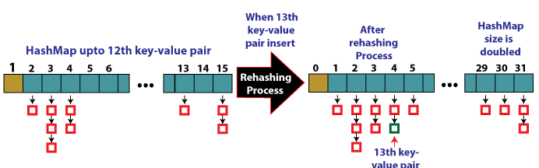
rehashing
When the number of items reaches 12, rehashing begins. (as 12 = 0.75 * 16)

Slide 290
Rehashing contd.
Rehashing can be done in the following way:
Check the load factor after adding a new entry to the map.
Rehash if it is more than the pre-defined value (or the default value of 0.75 if none is specified).
Make a new bucket array that is double the size of the previous one for Rehash.
Then go through each element in the old bucket array, calling insert() on each to add it to the new larger bucket array.

Slide 291
Rehashing (dynamic Table) Contd.

Slide 292
Extendible Hashing
Good for database that grows and shrinks in size
Allows the hash function to be modified dynamically
Extendable hashing – one form of dynamic hashing
Hash function generates values over a large range — typically b-bit integers, with b = 32.
At any time use only a prefix of the hash function to index into a table of bucket addresses.
Let the length of the prefix be i bits, 0 ≤ i ≤ 32.
Bucket address table size = 2^{i.} Initially i = 0
Value of i grows and shrinks as the size of the database grows and shrinks.
Similar to dynamic arrays

Slide 293
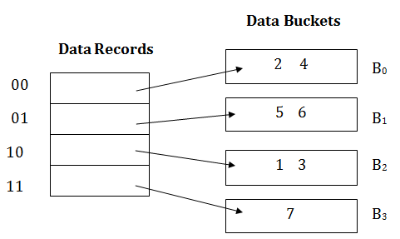
Extendible hashing
Dynamic hashing in DBMS:
Directories and buckets are used to hash data

